Slide 1
The Great Acceleration
By Will McWilliams

Slide 2
Intro
Is there a correlation between carbon emissions and climate change?
Which countries are the most responsible for the carbon emissions?
What are the main sources of carbon emissions?

Slide 3
Data Used
Carbon emissions data:
CDIAC (Carbon Dioxide Information Analysis Center)
Temperature data:
GISTEMP (GISS Surface Temperature Analysis)
Natural disaster data:
OFDA (Office of Foreign Disaster Assistance)

Slide 4

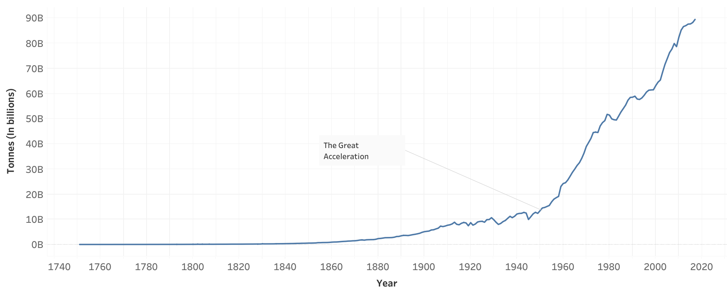
Total CO2 (1751-2017)

Slide 5
The Great Acceleration
Mid 20th century
Majority of countries on the planet
Exponentially increased its growth rate of progress
Increase of burning fossil fuels (coal, oil, natural gases, etc.), concrete Manufacturing, and Flaring

Slide 6
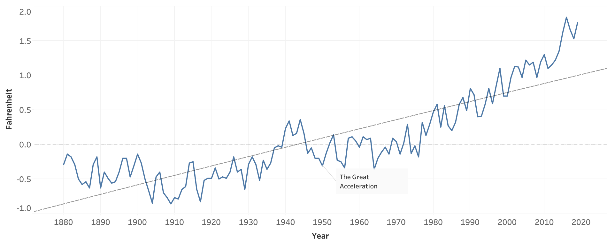
Global Temperature Averages (1880-2019)

Slide 7
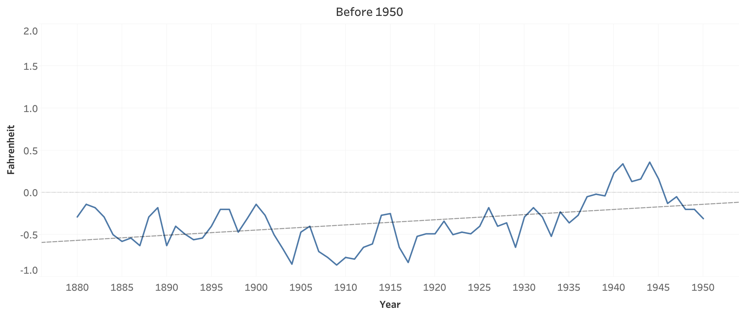
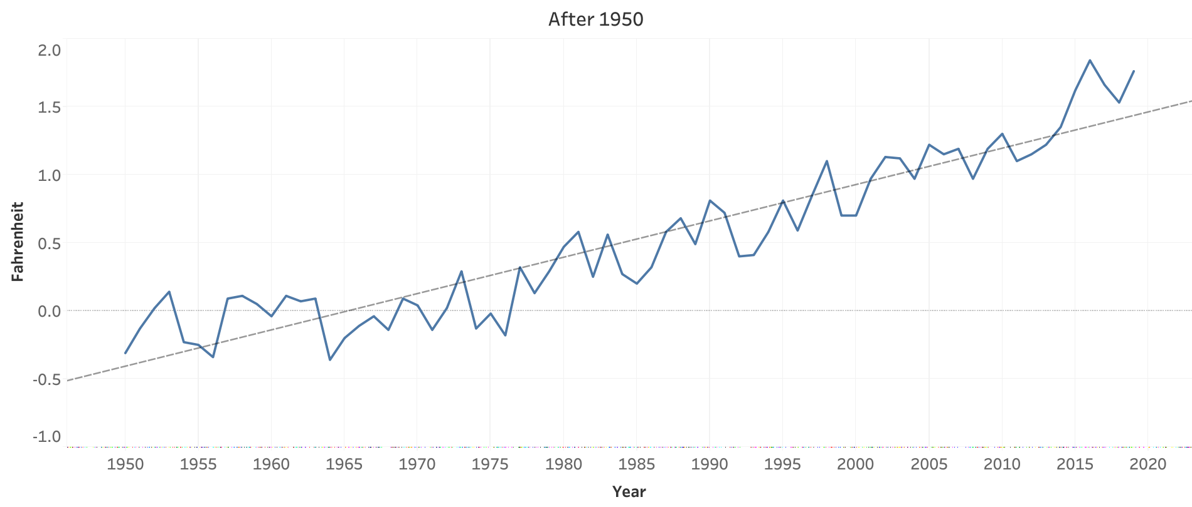
Before and After 1950

Slide 8
Natural Disasters
Extreme temperature
Extreme weather (hurricanes, tornadoes, cyclones)
Drought
Flood
Wildfire

Slide 9
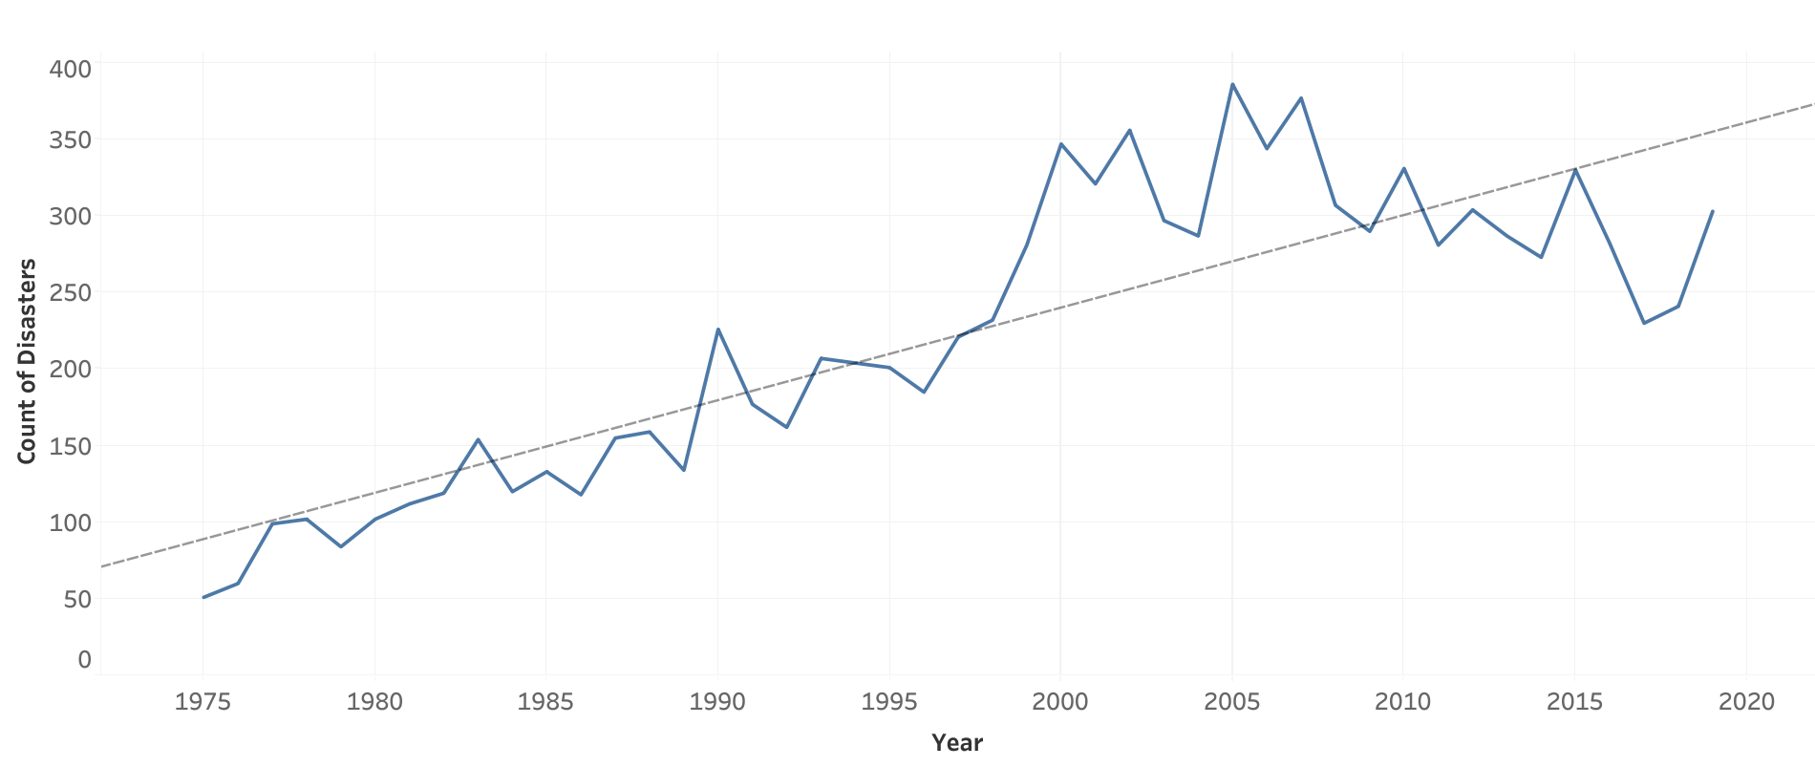
Natural Disasters (1975-2019)

Slide 10
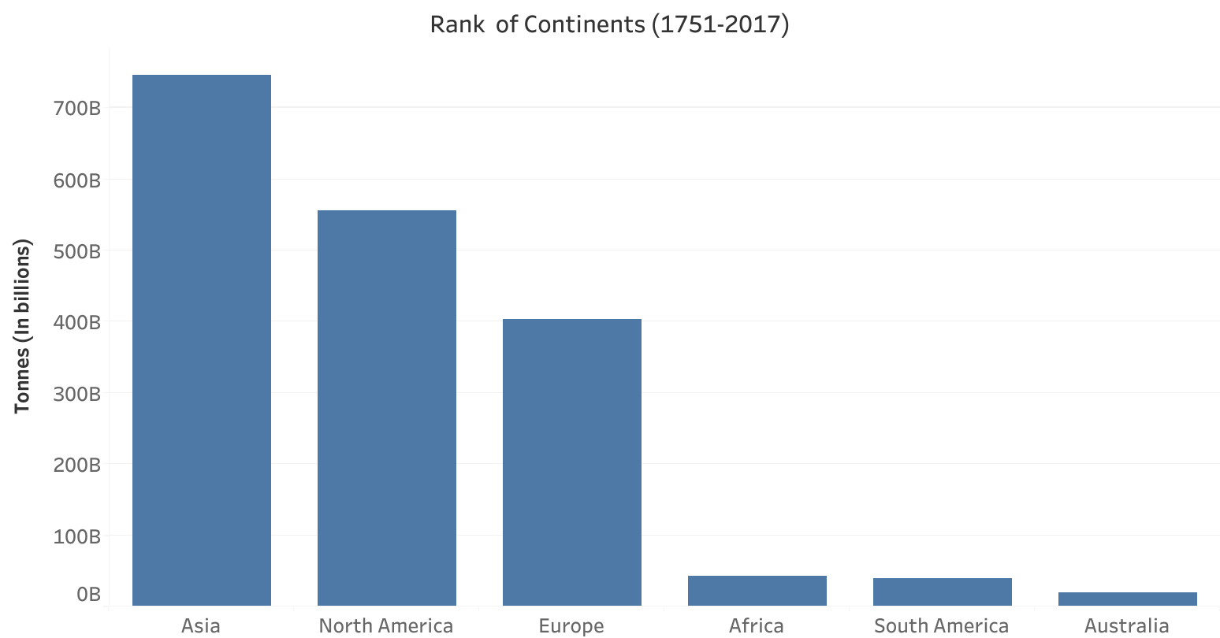
Rank of Continents

Slide 11
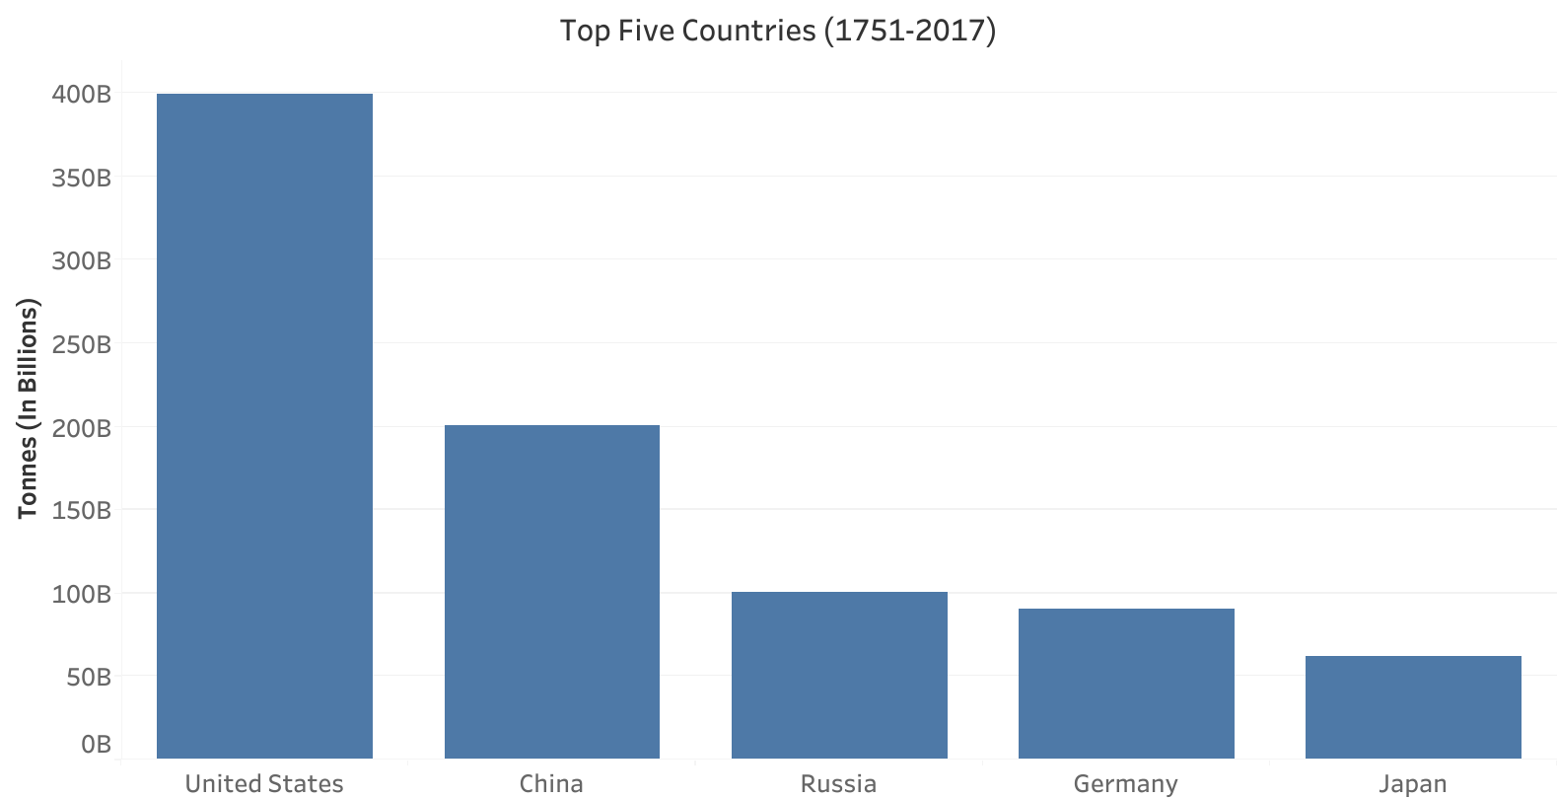
Top 5 Countries

Slide 12
Sources of Green House Gas
Coal (electricity and steel production)
Oil (transportation)
Natural Gas (electricity and industry)
Cement Production (infrastructure)
Flaring (crude oil extraction)

Slide 13
Conclusion
When carbon emissions rapidly increased, earths climate began to change at a faster rate
This rapid increase in carbon emissions is largely due to the demands created from an increasing global population, this period in history is referred to as The Great Acceleration

Slide 14
Conclusion cont.
The top five emitters are:
United States
China
Russia
Germany
Japan
Top five sources of carbon emissions:
Coal (electricity and steel production)
Oil (transportation)
Natural Gas (electricity and industry)
Cement Production (infrastructure)
Flaring (crude oil extraction)

Slide 15
Questions?

